Slide 1

Covid Viz-Hub
Group 10 Members:
Jacob Celestine (jc277)
Nisha Kumari (nk755)
Sihao Sun (ss3665)

Slide 2
Why this dataset?
The economic and social disruption caused by the pandemic is devastating: tens of millions of people are at risk of falling into extreme poverty, while the number of undernourished people are currently estimated at nearly 690 million.
We need ways to help people assess the risks involved, and understand what is happening around them. This would help them to take better, informed decisions.
Dashboards has become the iconic interface through which we understand the coronavirus pandemic. These visual displays are supposed to give us the information we need to act.
According to WHO, as of March 2022, COVID-19 had infected over 474M people and killed more than 6M worldwide.

Slide 3
Expected Target Users
Common People: To visualize and gain key insights to the spreading of the virus.
State & Federal Governments: To facilitate containment actions, planning or any public health measure that contributes to fighting the COVID-19 pandemic in the state or beyond if requested.
Local Businesses: To analyse the trend and take appropriate decisions.
Hospitals & Health Workers: As the people treating COVID patients, they need to kept updated about the trends and patterns happening around them.

Slide 4
Dataset Description
Sources: Time Series Data by JHU Case Surveillance Data by CDC
Size of CDC data: 5.82 GB in total; 430 KB/record Size of JHU data: 18.1 MB in total; 30.8 KB/record
Number of records being processed: 44.1M

Slide 5
Fundamental QUESTIONS
CDC Dataset | JHU Dataset
19 Columns | 11 fixed columns + Date columns
2 Quantitative fields | 5 Quantitative fields
17 Plain text fields | 6 Plain text fields
Updated every 2 weeks | Updated daily
Each row is a deidentified patient case | Each row shows changes to a country/ state per day.
Cross-sectional data | Time-series data

Slide 6
Dataset Snippet
CDC data:
JHU data:

Slide 7
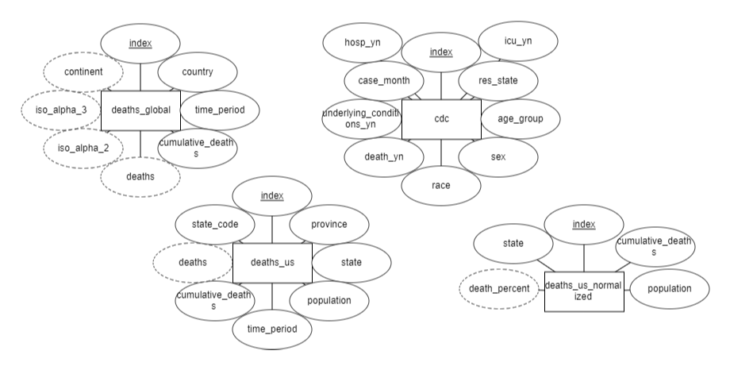
Entity Relationship Diagram

Slide 8
Data Insights and Interesting Findings Expected
Global level:
Latest death count across continents (Pie chart – Latest & Cumulative)
US level:
Situation across different periods of the outbreak (Line chart – Month Level)
Comparison between states based on percentage of deaths in each state? (Bar chart with drop down filters)
Which provinces accounted for the greatest number of deaths? (Sunburst chart)
Individual level:
Which race has the most deaths? (Bar chart)
Which gender has the most deaths? (Bar chart)
Was underlying condition a major factor in the deaths occurred? (Bar chart)
Which age group has the most deaths? (Bar chart)
Death count across months for different continents (Multi line chart– Monthly & Cumulative)
Spread of coronavirus across the world over the year?
Recovery rate of Coronavirus across the world over the year?
Trend of deaths across months for different continents (Choropleth map – Monthly & Cumulative)
Compare monthly deaths of countries (Multi line chart with drop down filters – Monthly & Cumulative)
Progress of covid deaths across states (Choropleth map – Monthly & Cumulative)
What was the situation in local hospitals like? (Stacked Bar chart)

Slide 9
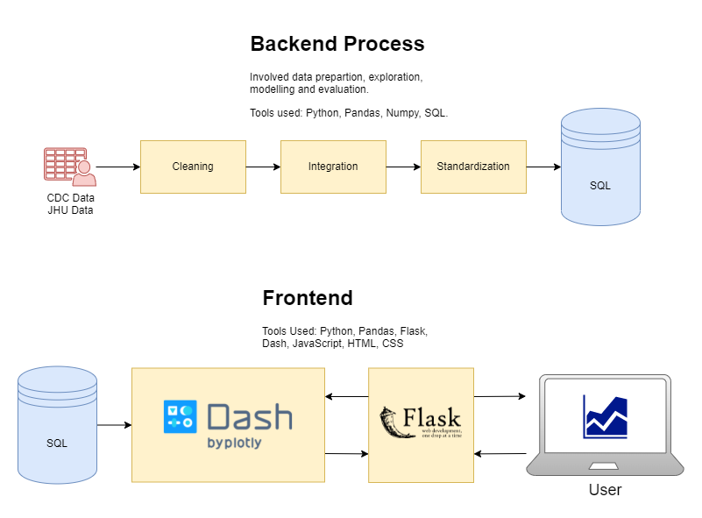
Conceptual Flowchart

Slide 10
Mode of Processing & Software Tools
Batch Processing of both CDC and JHU data.
Python: An interpreted high-level general-purpose programming language.
Plotly: Provides online graphing, analytics, and statistics tools for individuals and collaboration, as well as scientific graphing libraries for Python, R, MATLAB, Perl, Julia, Arduino, and REST.
Dash: Dash is a python framework created by Plotly for creating interactive web applications. It is written on the top of Flask, Plotly.js and React.js.
Pandas: A fast, powerful, flexible and easy to use open source data analysis and manipulation tool, built on top of the Python programming language.
Flask: A web framework and Python module that lets you develop web applications easily.
JavaScript: High-level, often just-in-time compiled, and multi-paradigm programming language.
HTML and CSS: Used to construct and style the frontend.
SQL: A standardized programming language that is used to manage relational databases and perform various operations on the data in them.

Slide 11
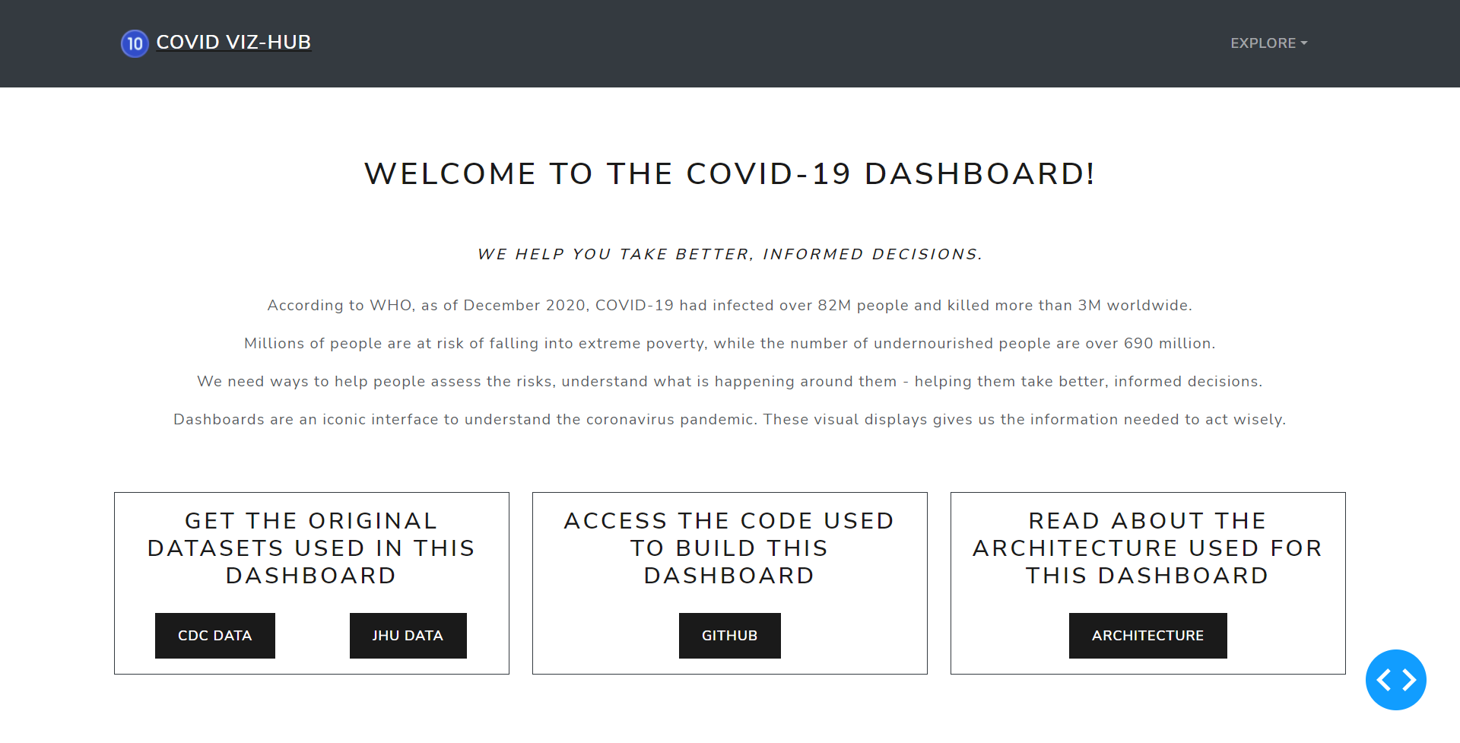
ScreenshoTs

Slide 12
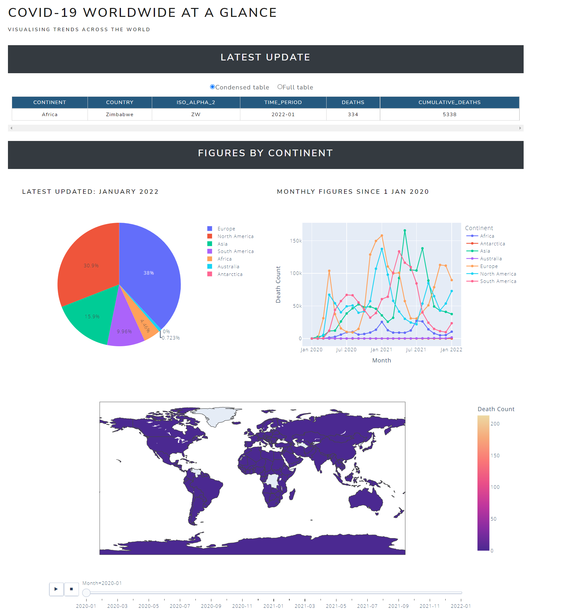
ScreenshoTs

Slide 13
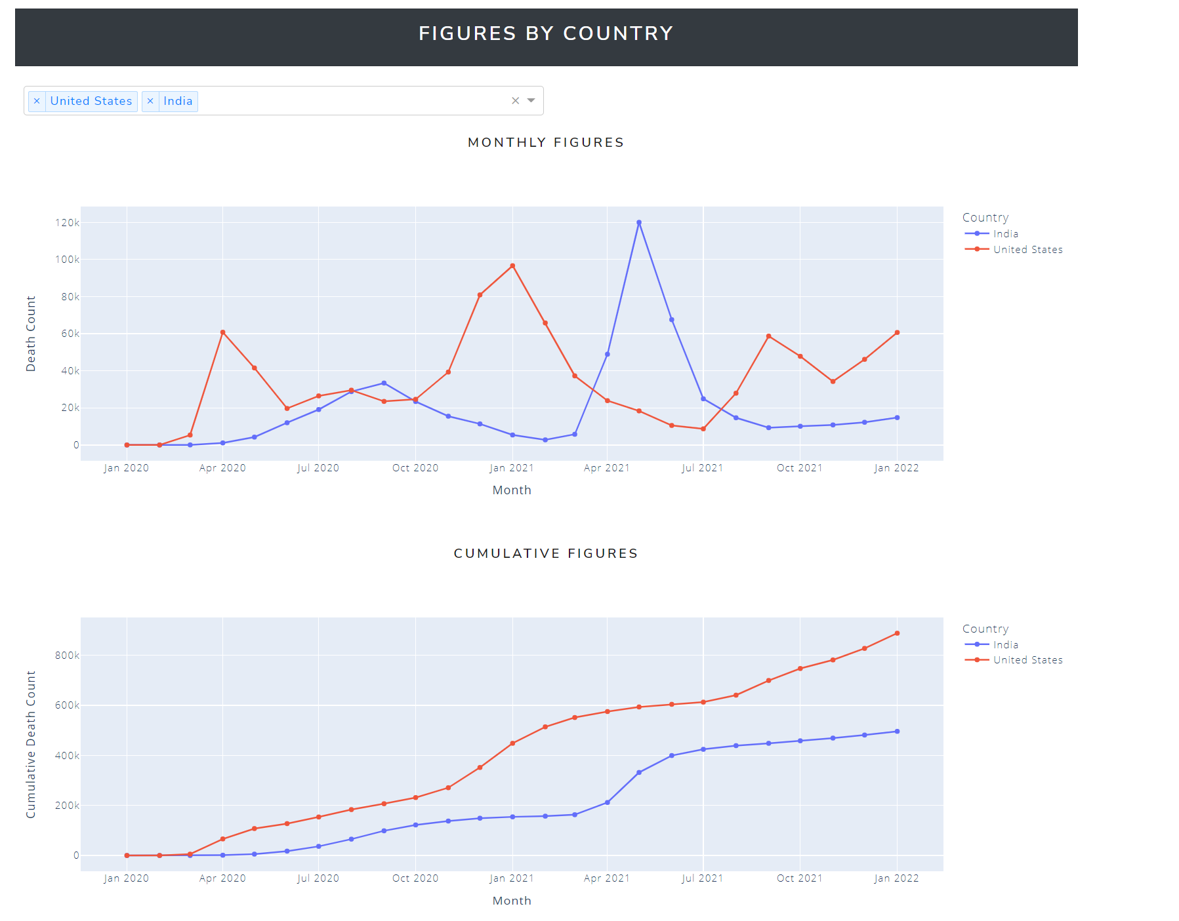
ScreenshoTs

Slide 14
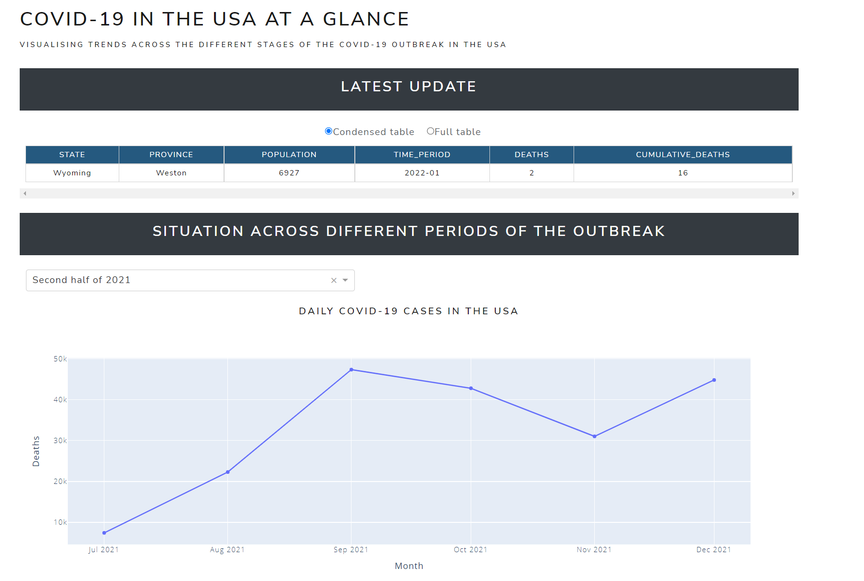
ScreenshoTs

Slide 15
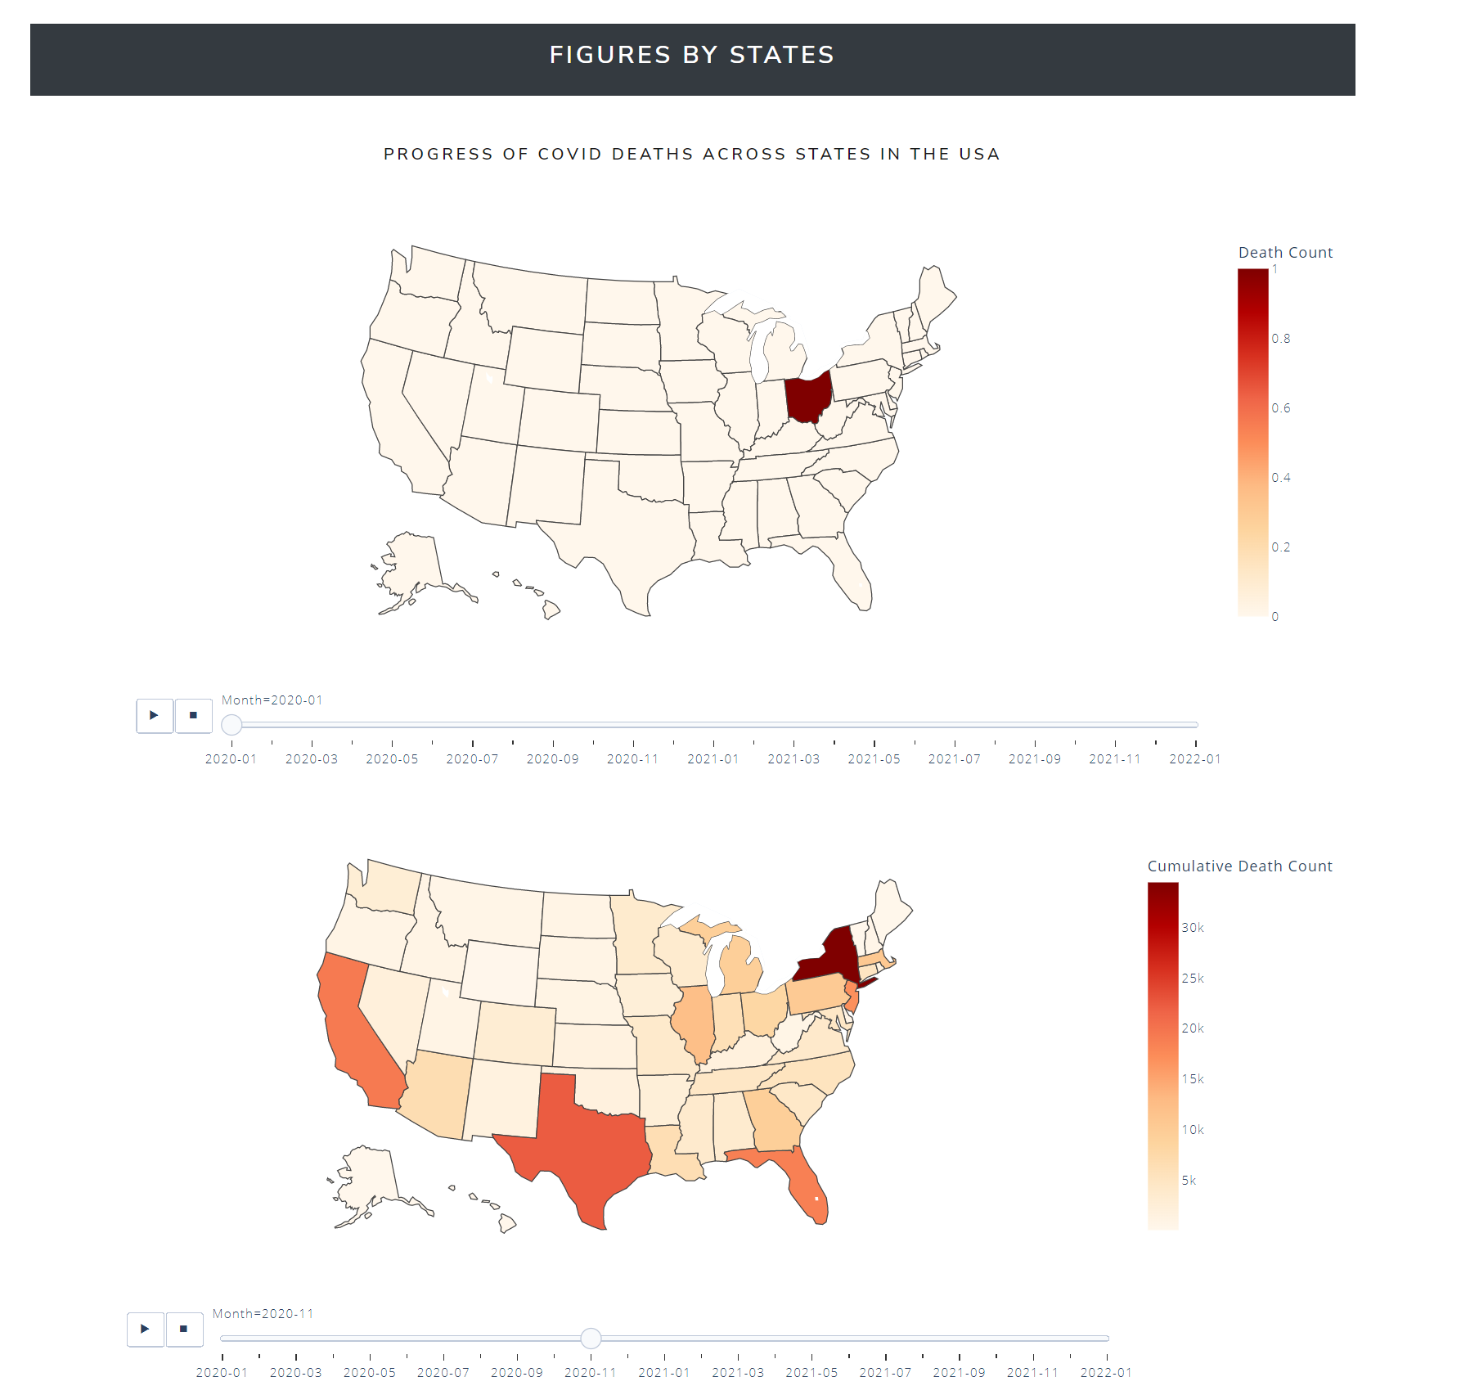
ScreenshoTs

Slide 16
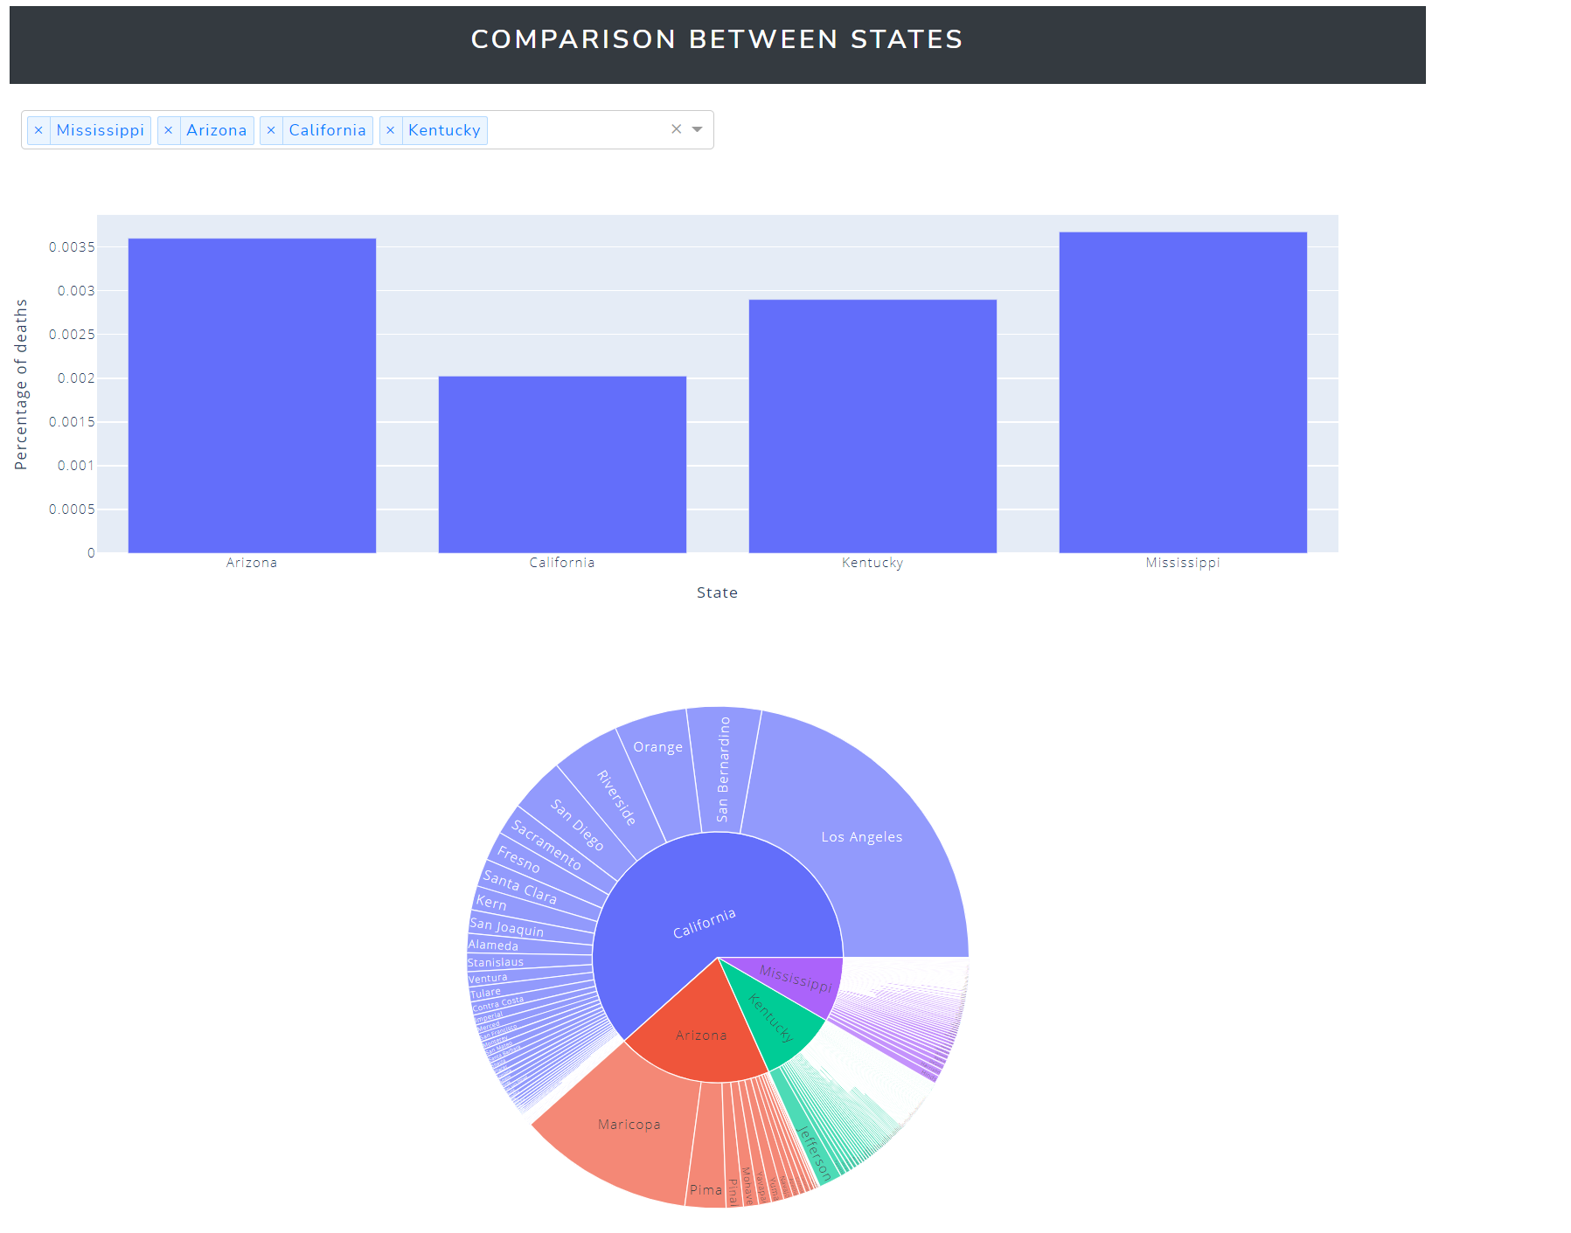
ScreenshoTs

Slide 17
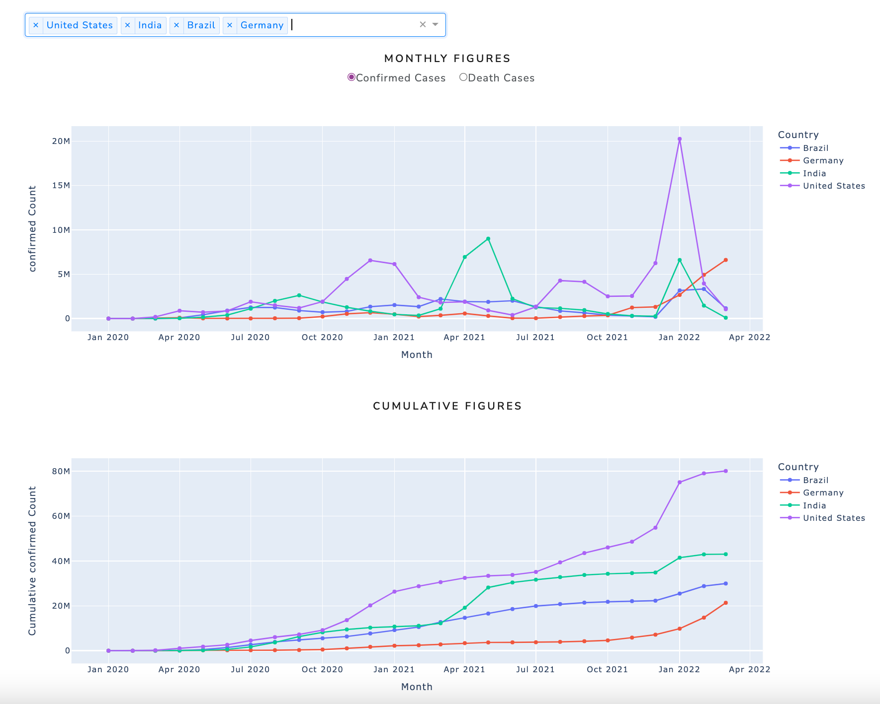
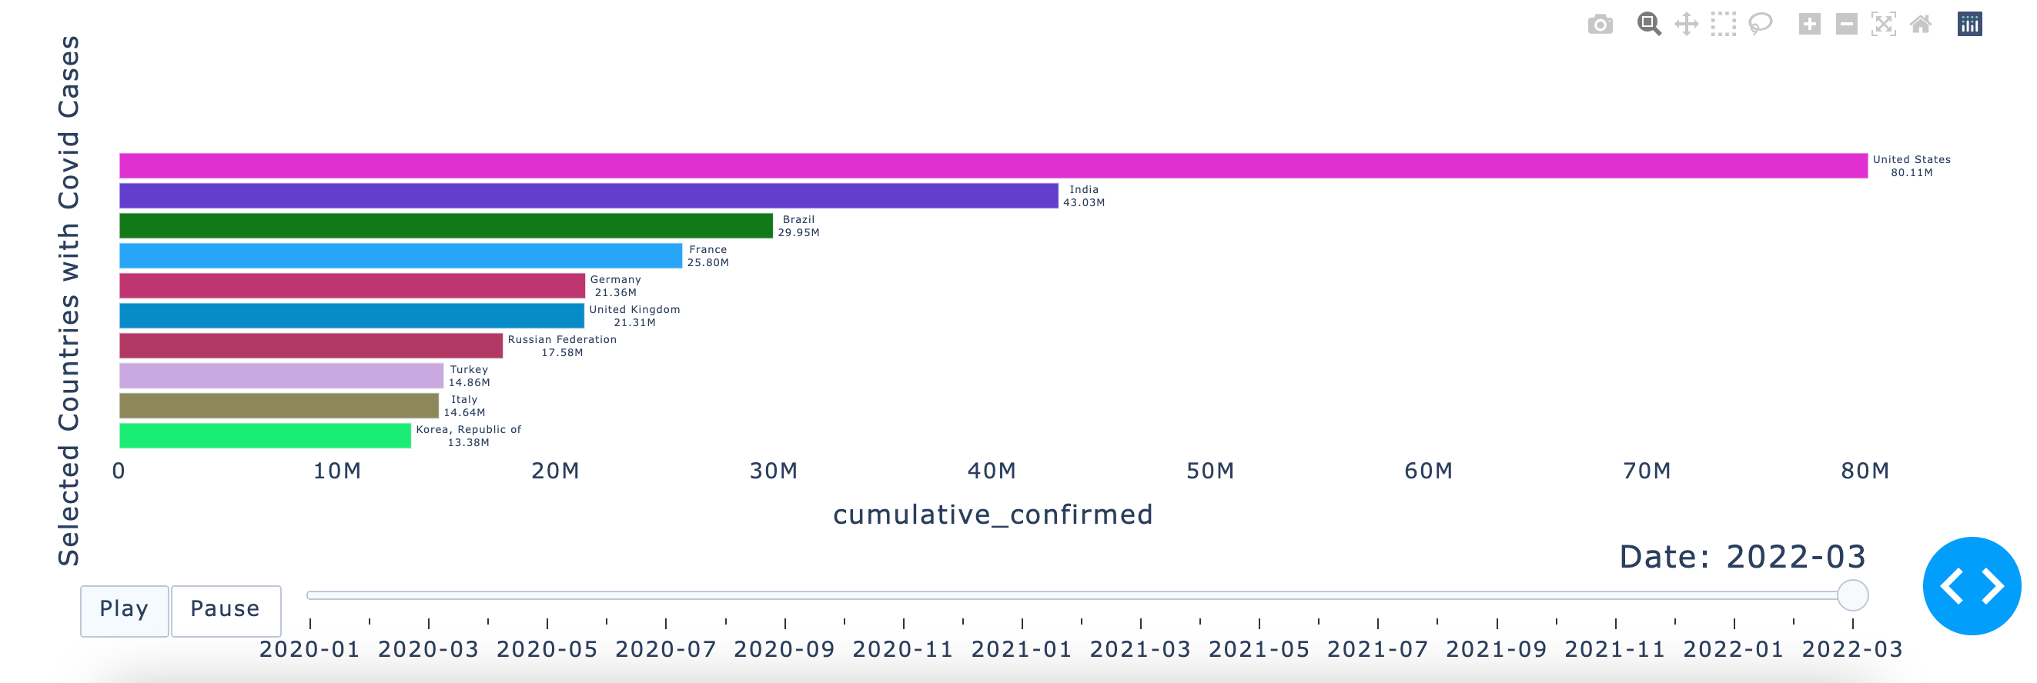
Screenshots
Interactive Dynamic Multi-optional Line Plot
Racing Bar Plot

Slide 18
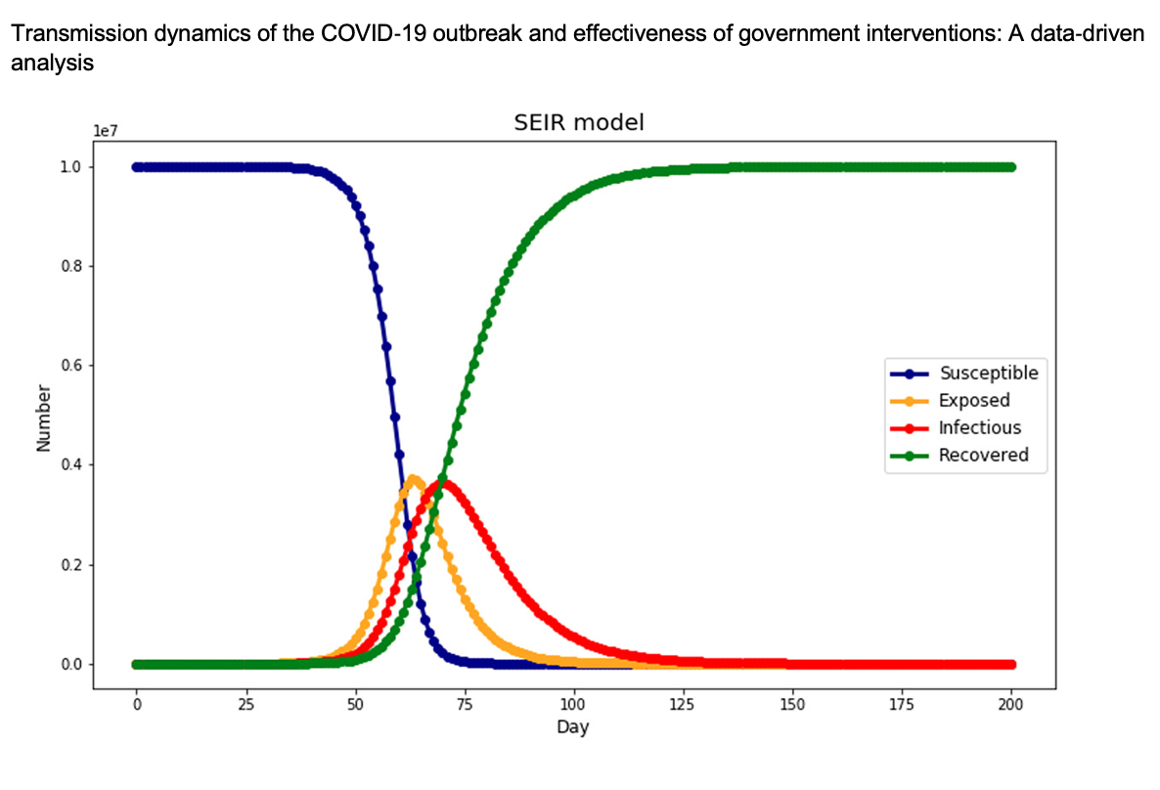
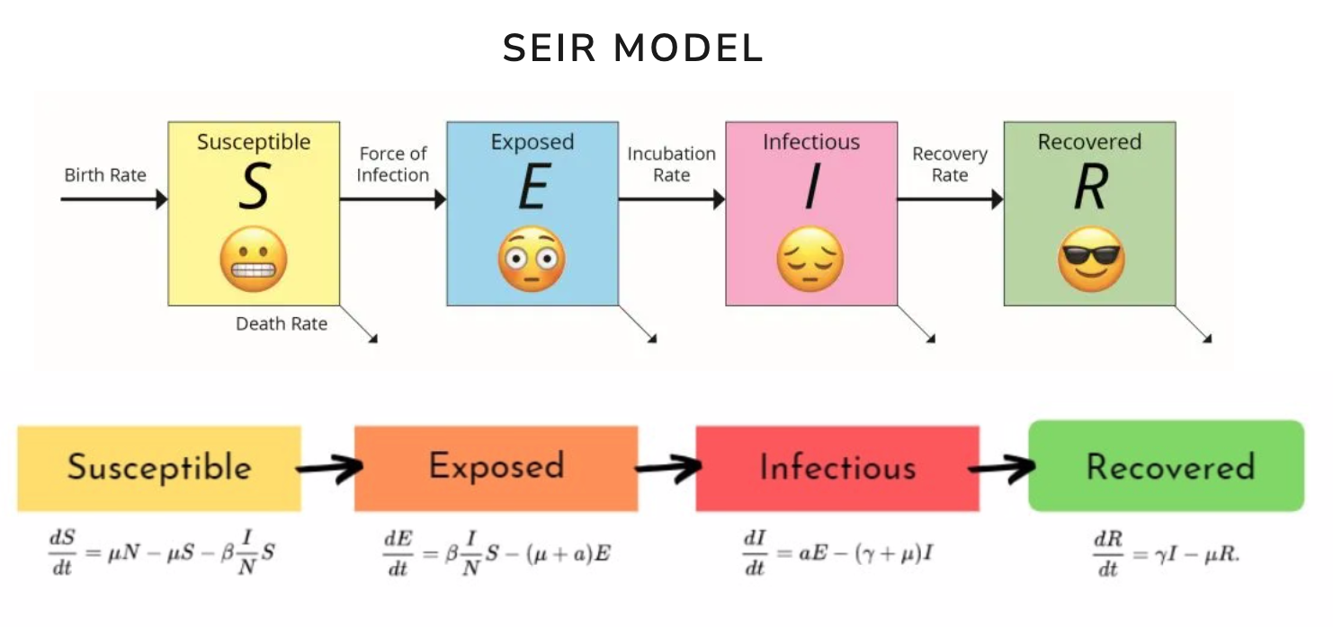
COVID ANALYTICS : seir model

Slide 19
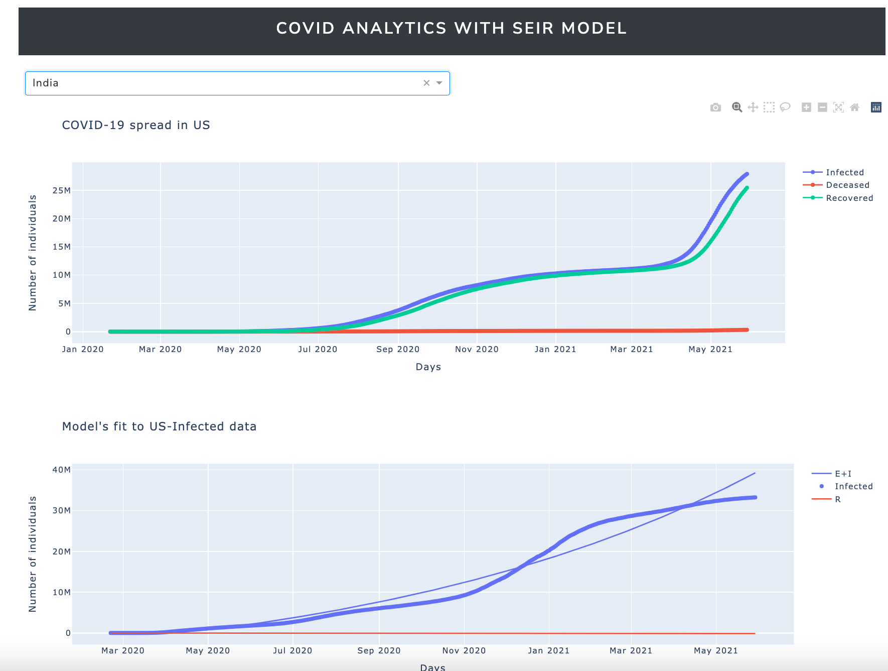
COVID ANALYTICS

Slide 20
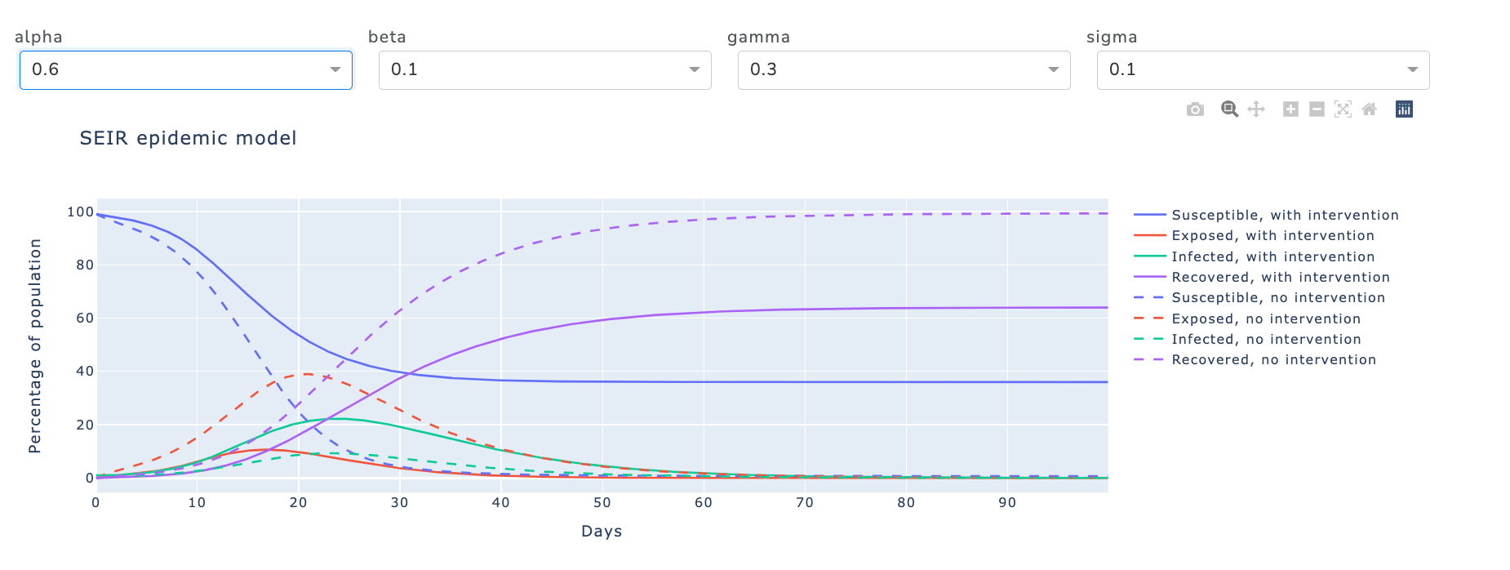
Interactive dynamic seir simulated plot

Slide 21
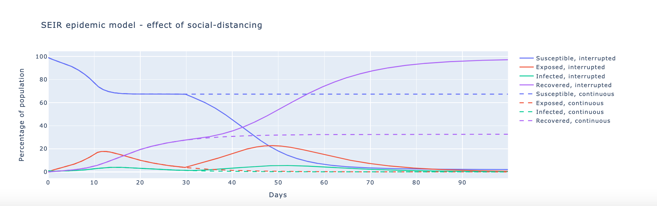
seir simulated plot with social distancing

Slide 22

Demo

Slide 23
Interactivity FEATURES
Allows users to interact with graphs on display, allowing for a better storytelling experience.
Supports various interactive features such as:
Animations for time series data
Subset exploration
Zooming in and out
Point value display
Drop down filters
Panning graphs
Visiting data at a specific time period.

Slide 24
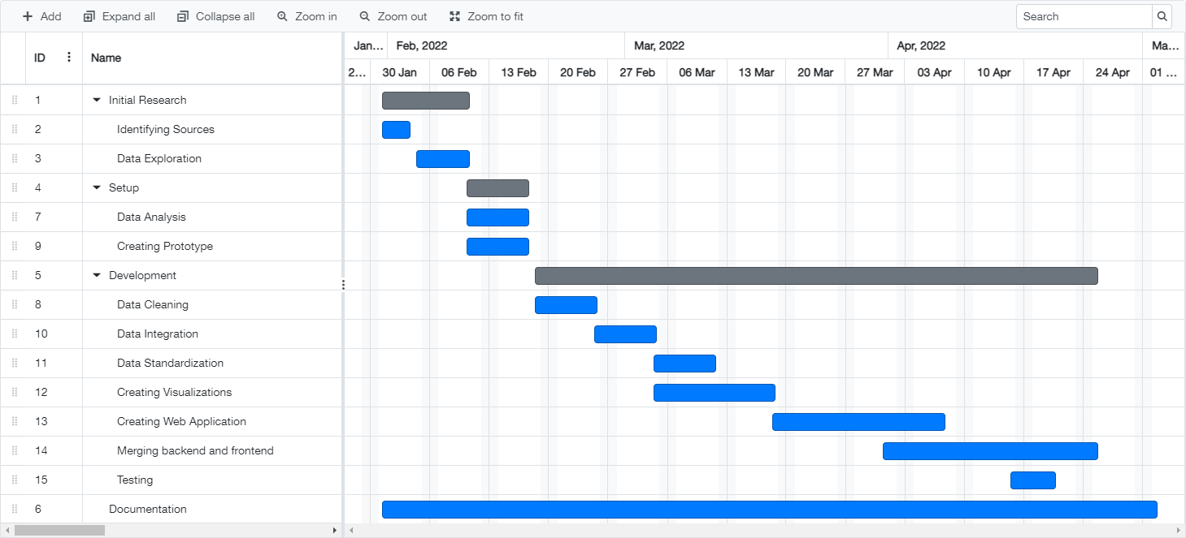
Gantt Chart

Slide 25
Future Work
The entire application can be extended to include comparisons between states in countries other than the US.
A model can be built to predict the trends in different states based on the past data and other features, which will help the government takes preemptive measures.
The application can be built into a one stop place for Covid, by adding features like latest news, recommendations from WHO etc.

Slide 26
Conclusion
In conclusion, this entire project experience has taught us to:
Use Plotly, Dash, and SQL for creating beautiful visualization and dashboards.
Learn the various stages in creating a dashboard such as extraction, cleaning, transforming, and modelling the data.
Gave a better understanding on how to deal with analytics on real word entities.
Understand how to normalize and reduce the data to make it suitable for visual analytics.
Handle large datasets with a record size of around 500 bytes.

Slide 27
References
https://plotly.com/
https://pandas.pydata.org/
https://en.wikipedia.org/wiki/SQL
https://plotly.com/dash/
https://flask.palletsprojects.com/en/2.0.x/
https://github.com/CSSEGISandData/COVID-19
https://data.cdc.gov/Case-Surveillance/COVID-19-Case-Surveillance-Public-Use-Data-with-Ge/n8mc-b4w4

Slide 28

Thank YOu

